Slide 1



Introduction to Xamarin
Allan Pead
@adpead
Xamarin MVP, Microsoft MVP, Xamarin Insider

Slide 2
Architecting Mobile Apps
Notes:
So we know what we want how do we get there? Let’s talk about the state of mobile development.

Slide 3

Silo Approach
iOS
Android
Windows
Objective-C
Xcode
Java
Android Studio
C#
Visual Studio
No shared code • Many languages & development environments • Multiple teams
Notes:
Multiple Teams
Multiple Code Bases
Expensive & Slow
Positive = Great apps delivered to user’s platform
Negative = Development hampered by multiple code bases & fragmentation

Slide 4
Write Once, Run Anywhere
Lua
Javascript
Actionscript
HTML+CSS
App Generator
Limited native API access • Slow performance • Poor user experience
Notes:
Unhappy Users
Unhappy Developers
Increase in Abandoned Apps
Limited to what is implemented

Slide 5
Xamarin’s Unique Approach
iOS C# UI
Android C# UI
Windows C# UI
Shared C# Mobile
Shared C# codebase • 100% native API access • High performance

Slide 6
Windows APIs
Microsoft.Phone
Microsoft.Networking
Windows.Storage
Windows.Foundation
Microsoft.Devices
System.Net
System
System.IO
System.Linq
System.Xml
System.Data
System.Windows
System.Numerics
System.Core
System.ServiceModel
C#

Slide 7
iOS – 100% API Coverage
MapKit
UIKit
iBeacon
CoreGraphics
CoreMotion
System.Net
System
System.IO
System.Linq
System.Xml
System.Data
System.Windows
System.Numerics
System.Core
System.ServiceModel
C#

Slide 8
Android – 100% API Coverage
Text-to-speech
ActionBar
Printing Framework
Renderscript
NFC
System.Net
System
System.IO
System.Linq
System.Xml
System.Data
System.Windows
System.Numerics
System.Core
System.ServiceModel
C#

Slide 9
Building User Interfaces
Notes:
So we know what we want how do we get there? Let’s talk about the state of mobile development.

Slide 10



Traditional UI approach
iOS C#
Android C#
Windows C#
Shared C# Logic
3 Native User Interfaces
Shared App Logic

Slide 11
Let’s see it!
Notes:
So we know what we want how do we get there? Let’s talk about the state of mobile development.

Slide 12

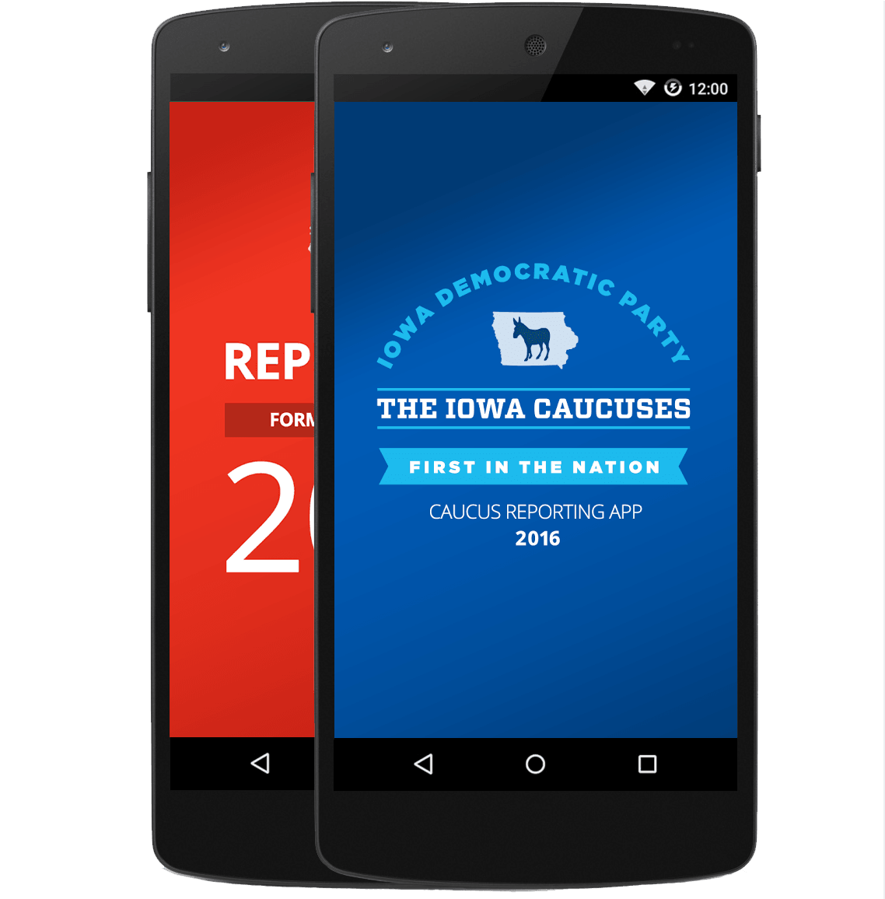
Xamarin.Forms approach
Shared UI Code
Shared C# Logic
Shared User Interface
Shared App Logic

Slide 13
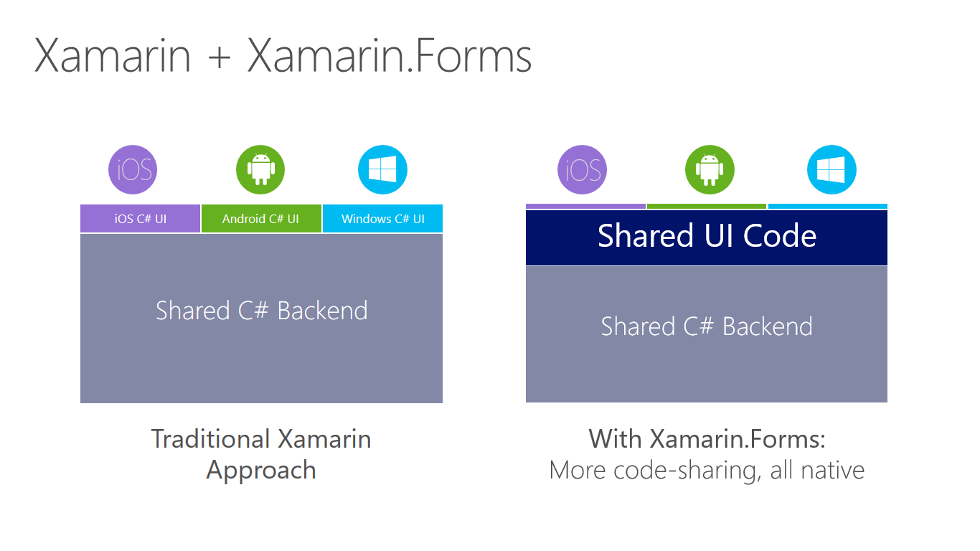

Slide 14
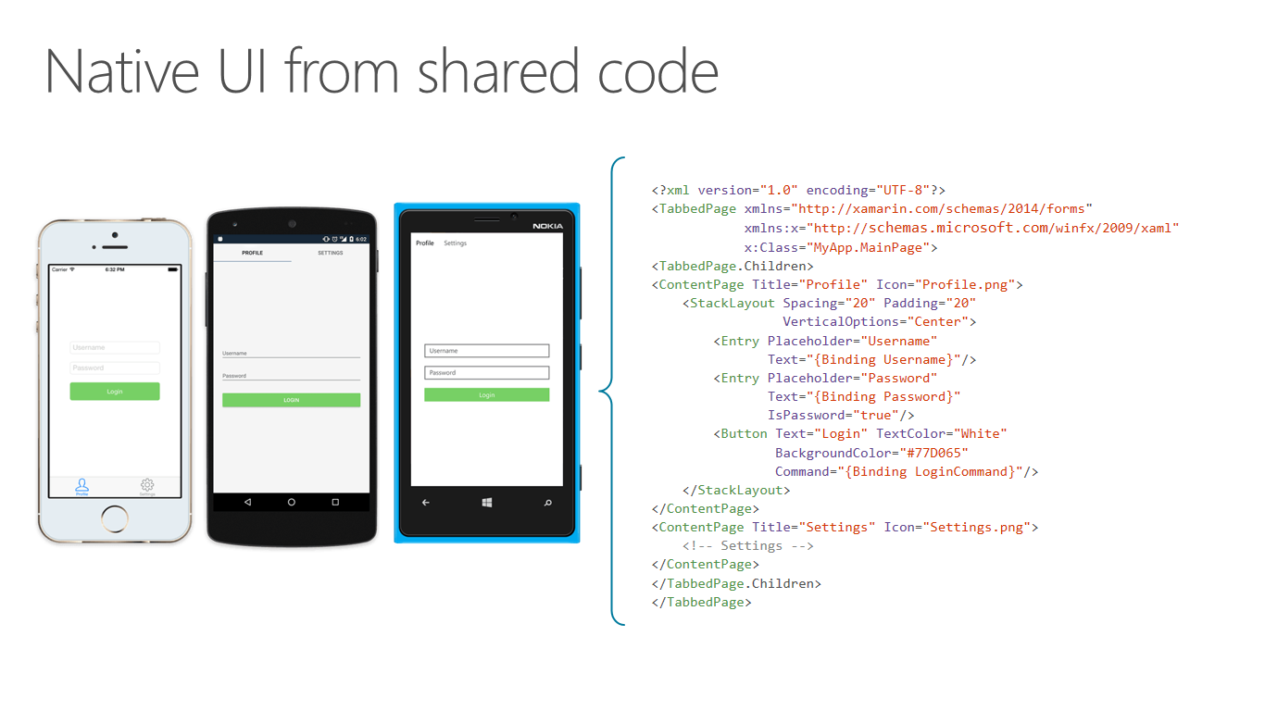

Slide 15
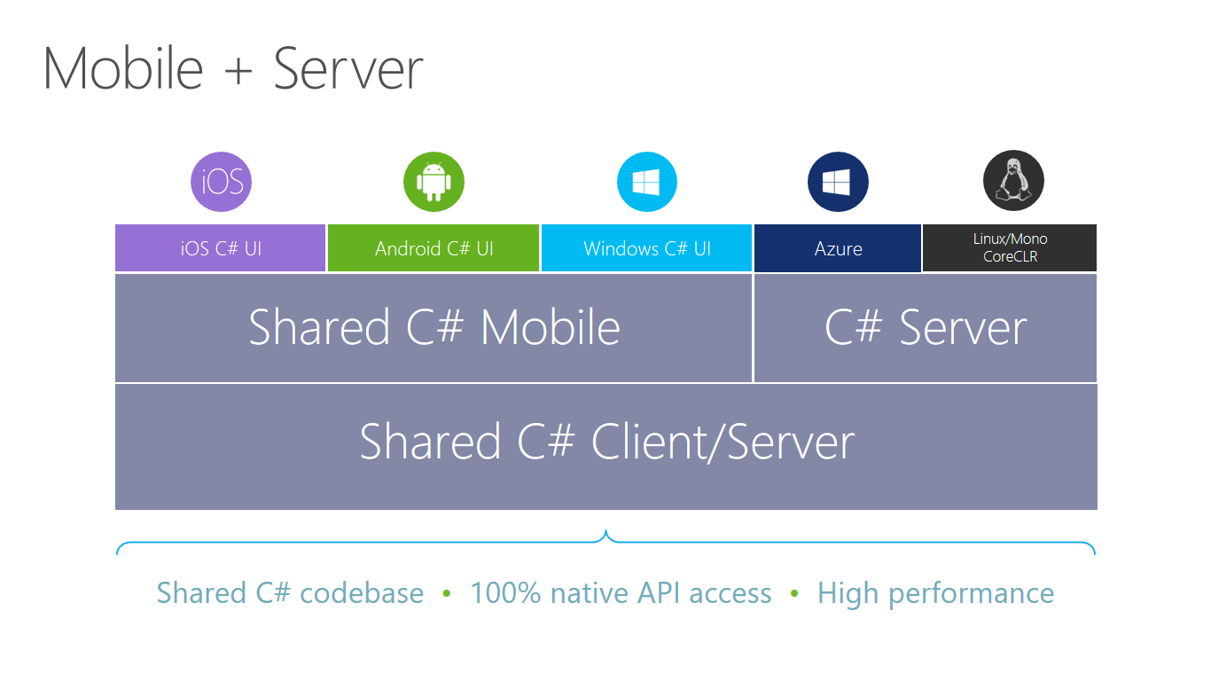

Slide 16
UrhoSharp
CocosSharp
Notes:
Many popular and powerful game engines already leveraging C# are lifted by Mono runtime move to MIT license

Slide 17
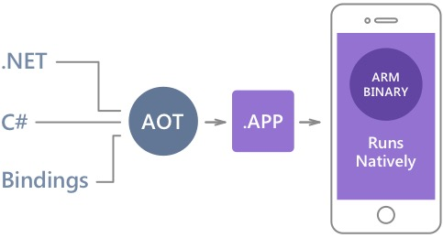
Native Performance
Xamarin.iOS does full Ahead Of Time (AOT) compilation to produce an ARM binary for Apple’s App Store.
Xamarin.Android takes advantage of Just In Time (JIT) compilation on the Android device.

Slide 18
✓Always Up-to-Date
Same-day support:
iOS 5
iOS 6
iOS 7
iOS 8
iOS 9
iOS 10
Full support for:
Apple Watch
Android Wear
Amazon Fire TV
Google Glass
and much more

Slide 19
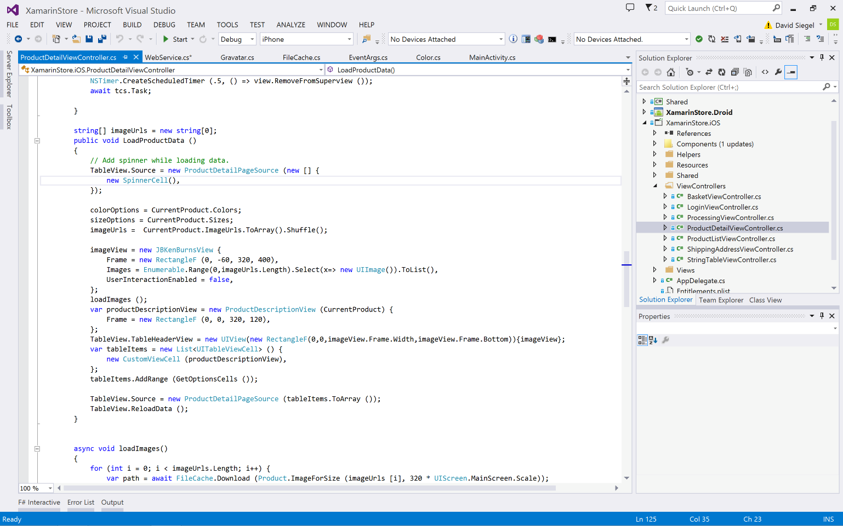
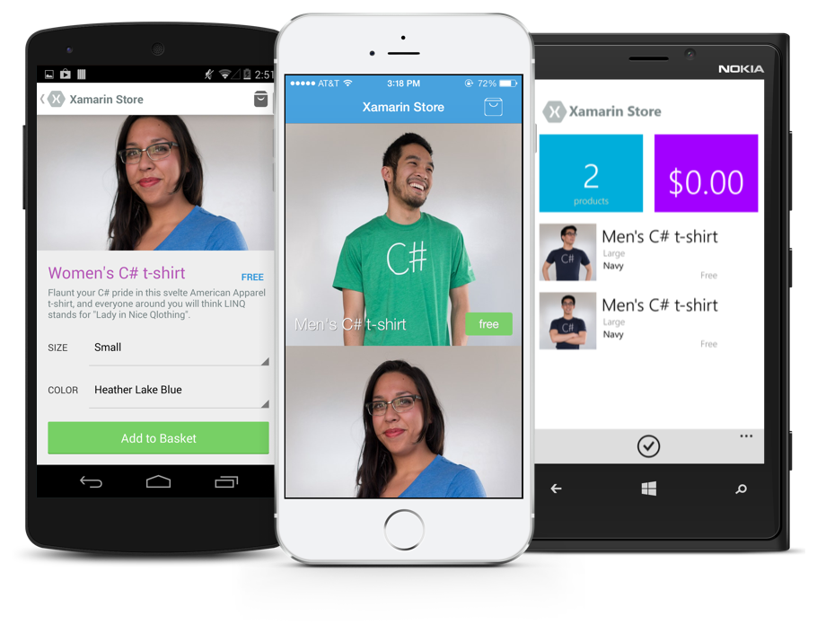
Anything you can do in Objective-C, Swift, or Java can be done in C# with Xamarin.
Notes:
Coming up next is bubbles

Slide 20
Development Experience

Slide 21
Xamarin is included in Visual Studio
Xamarin is included
in Visual Studio
Including Community Edition!

Slide 22

Open Source – open.xamarin.com

Slide 23
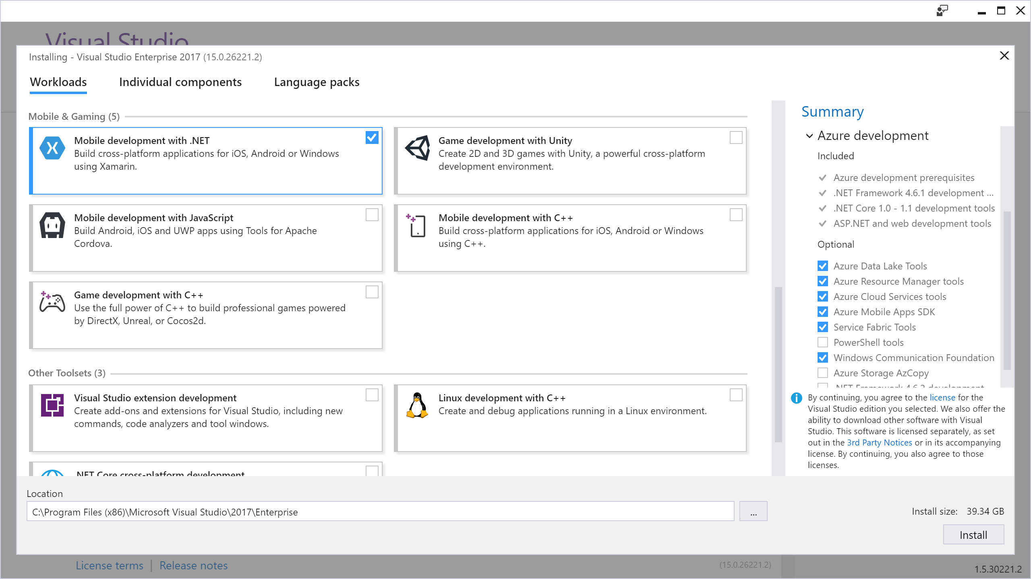
Visual Studio Integration
Xamarin.com/Download

Slide 24
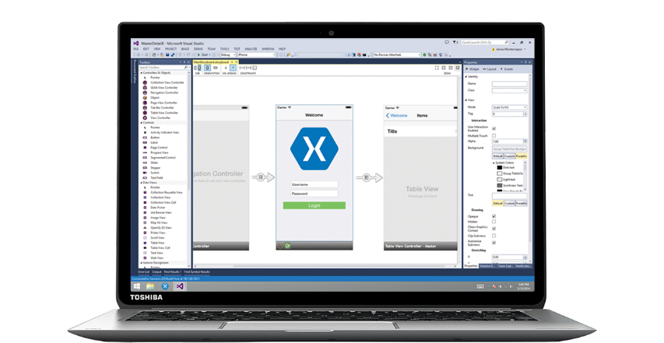
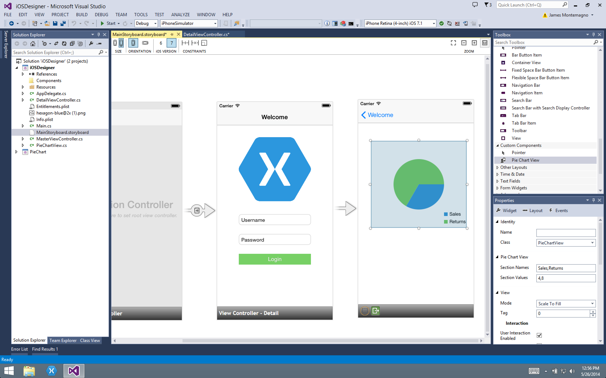
Xamarin for Visual Studio

Slide 25
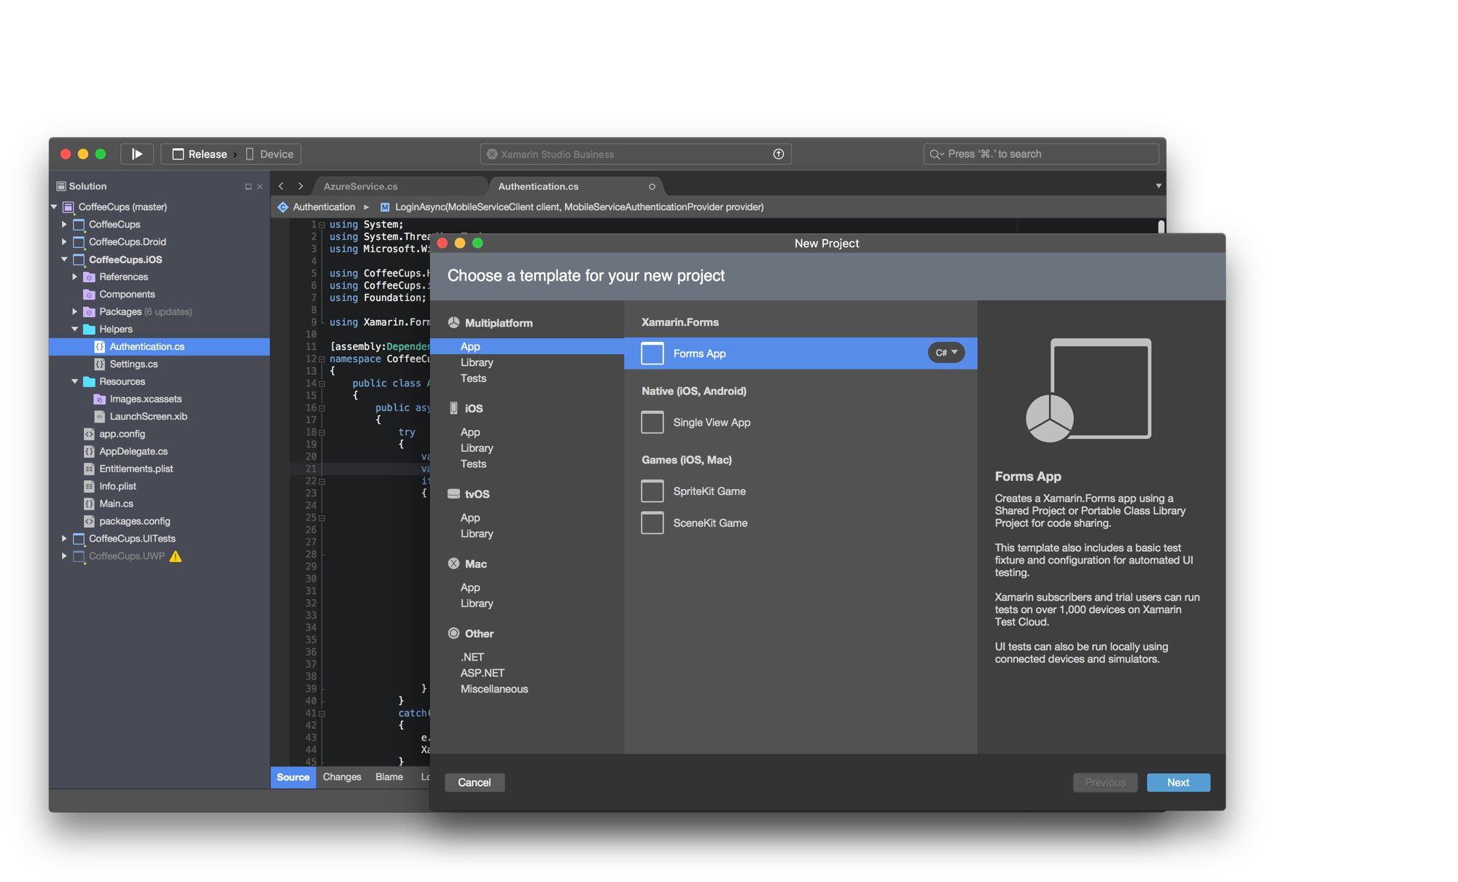

Xamarin Studio – Mac
Notes:
Xamarin Studio on Mac offers: Android, iOS and Mac development
World Class IDE with great features:
Code Analysis
Upload to Test Flight
Git & Subversion Integration
Code Completion
Code Navigation
Easy transition from Visual Studio
The same Solution & Projects open in BOTH Xamarin Studio and Visual Studio!

Slide 26

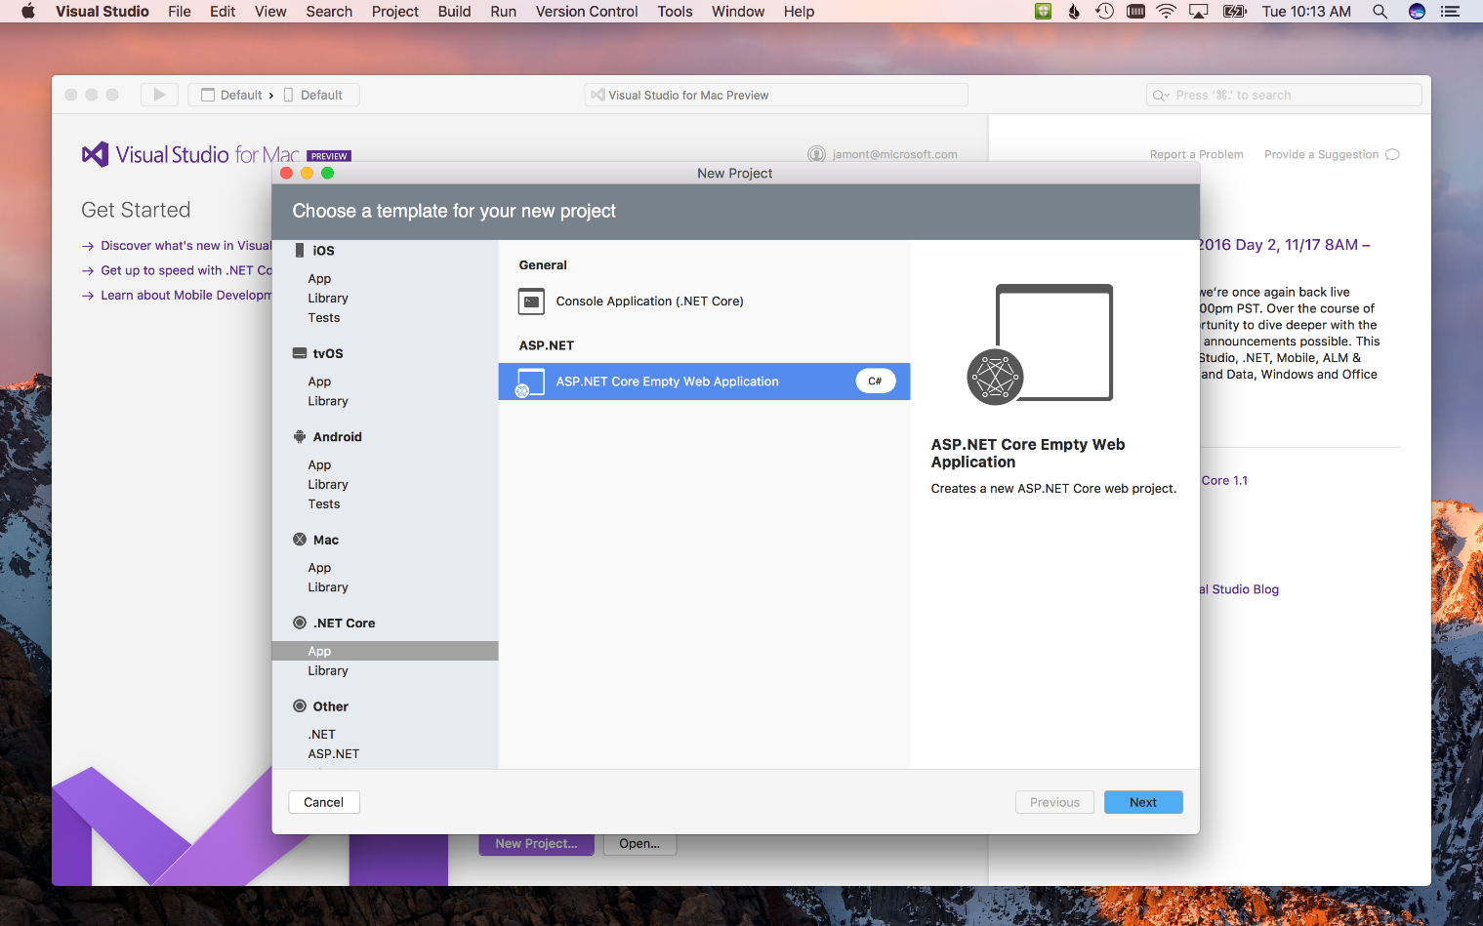
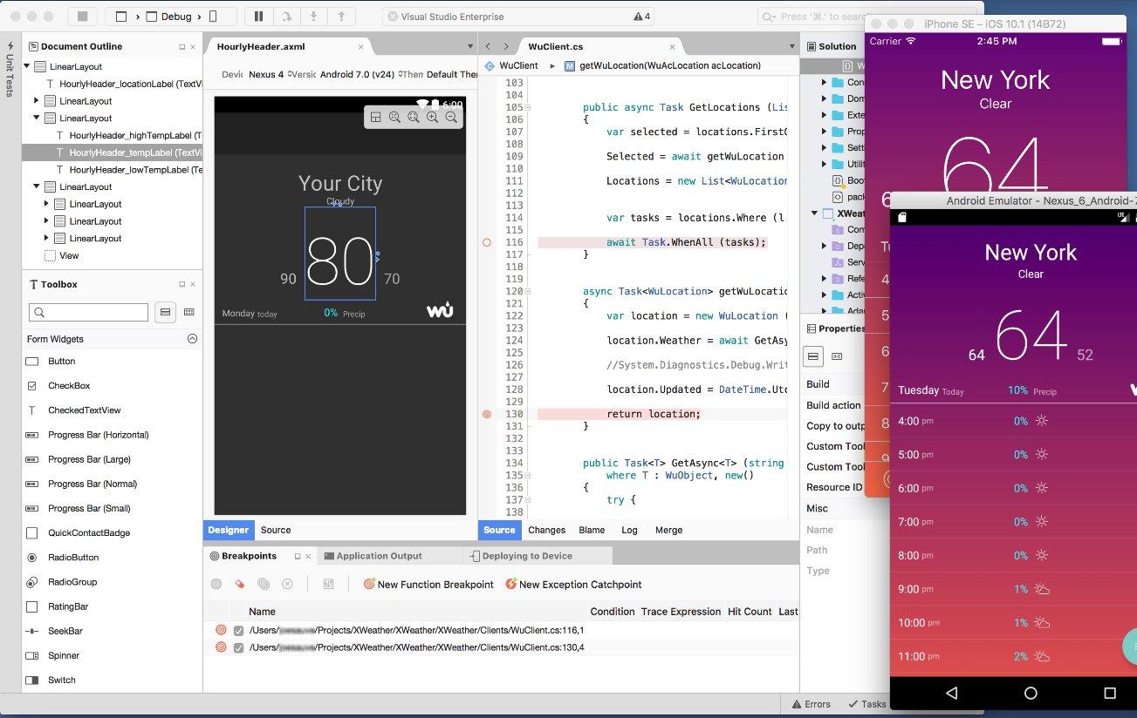
Visual Studio for Mac (Preview)
iOS, Android, & macOS
.NET development
.NET Core & ASP.NET Core
Tools for Azure
Notes:
The biggest surprise was the brand new Visual Studio for Mac!
In preview today and is the next evolution of Xamarin Studio.
Includes Azure Tools and .NET Core work loads. More in the future.

Slide 27
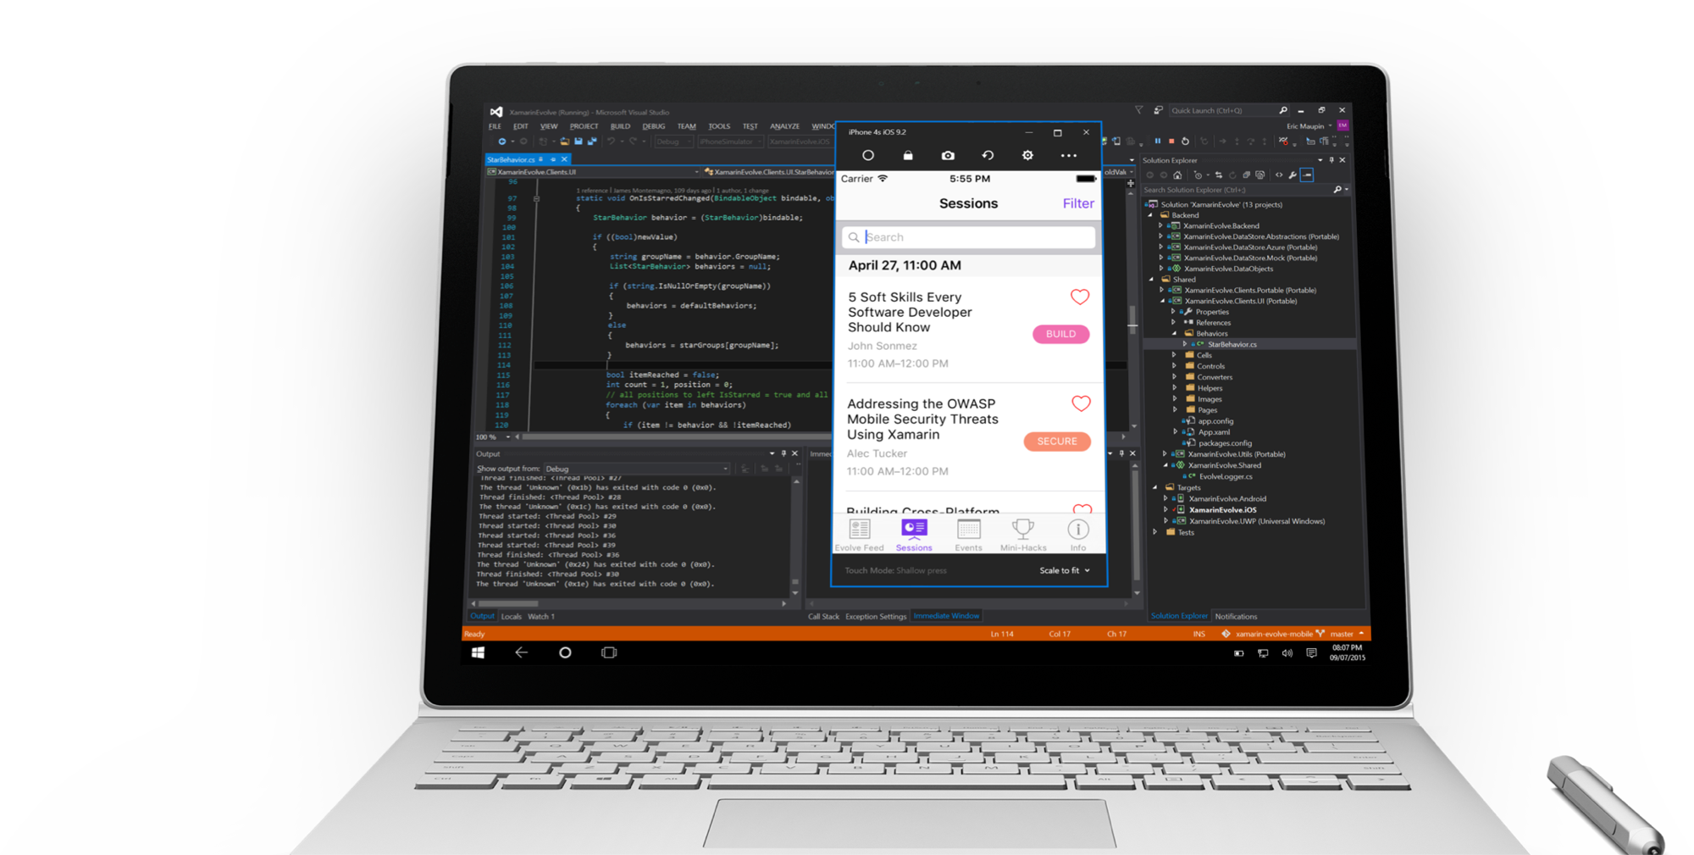
Visual Studio iOS Simulator Remoting
Multi-Touch Enabled
Pressure Sensitive
Super Fast
Rotate, screenshots, location changes
Never leave VS
*Requires Visual Studio Enterprise

Slide 28
Streamlined Development

Slide 29
Shared C# Backend

Slide 30
Platform Specific Code
UI+APIs
UI + APIs
UI + APIs
Battery
GPS
Lights
Notifications
Settings
Text To Speech
Battery
GPS
Lights
Notifications
Settings
Text To Speech
Battery
GPS
Lights
Notifications
Settings
Text To Speech
What if we didn’t have to write this code?
What if we could access it from shared code?

Slide 31
Speak(“Hello World”);
AVSpeechSynthesizer
TextToSpeech
SpeechSynthesizer

Slide 32
Plugins for Xamarin
github.com/xamarin/plugins
Common API
Notes:
Show VS

Slide 33





Microsoft’s complete mobile DevOps solution
Develop
Test
Build
Distribute
Monitor

Slide 34
Live Update
Crash Reporting
A/B Testing
Storage
Identity
Push Notifications
Remote Config.
Tables

Slide 35
Visual Studio Mobile Center
A/B Testing
Push Notifications
Crash Reporting
Remote Config.
Identity
mobile.azure.com
Tables
Live Update
Storage

Slide 36
Thank You!
Local Slack Community
https://zatech.slack.com #xamarin
Xamarin Learning Resources
https://developer.xamarin.com/guides/
Xamarin University
https://www.xamarin.com/university
Learn and share with your local community
Xamarin User Groups
Cape Town (@CTXUG)
Johannesburg (@GXUGSA)
Durban (@DXUGSA)
Allan Pead
Xamarin MVP, Microsoft MVP,
Xamarin Insider
Email: adpead@gmail.com
Blog: http://www.explorationspace.co.za
Twitter: @adpead

